Slide 1
LECTURE 10
Project Communication Management

Slide 2
Learning Objectives
Understand the importance of good communications on projects and the need to develop soft skills, especially for IT project managers and their teams
Review key concepts related to communications
Explain the elements of planning project communications and how to create a communications management plan
Describe how to manage communications, including communication technologies, media, and performance reporting

Slide 3
Learning Objectives
Discuss methods for controlling communications to ensure that information needs are met throughout the life of the project
List various methods for improving project communications, such as running effective meetings, using various technologies effectively, and using templates
Describe how software can enhance project communications management

Slide 4
Importance of Good Communications
The greatest threat to many projects is a failure to communicate
Our culture does not portray IT professionals as being good communicators
Research shows that IT professionals must be able to communicate effectively to succeed in their positions
Strong verbal and non-technical skills are a key factor in career advancement for IT professionals

Slide 5
2014 Study on Importance of Non-technical Skills
Most important non-technical skills include problem solving, teamwork, and listening
Some organizations will hire individuals with minimal technical skills so long as they demonstrate solid soft and business skills

Slide 6
Project Communications Management Processes
Planning communications management: Determining the information and communications needs of the stakeholders
Managing communications: Creating, distributing, storing, retrieving, and disposing of project communications based on the communications management plan
Controlling communications: Monitoring and controlling project communications to ensure that stakeholder communication needs are met

Slide 7
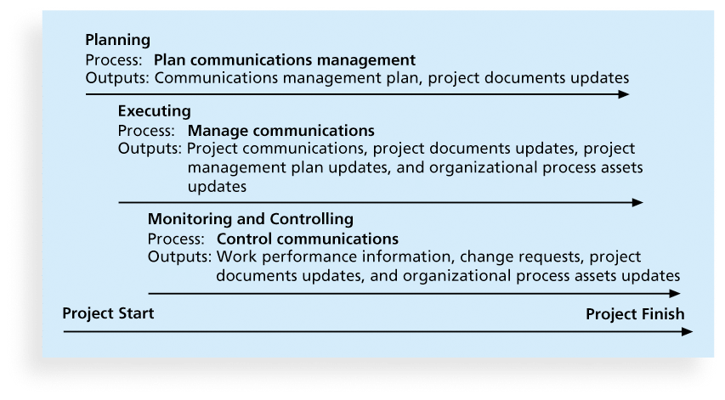
Figure 10-1. Project Communications Management Summary

Slide 8
Importance of Face-to-Face Communication
Research says that in a face-to-face interaction:
58 percent of communication is through body language.
35 percent of communication is through how the words are said
7 percent of communication is through the content or words that are spoken
Pay attention to more than just the actual words someone is saying
A person’s tone of voice and body language say a lot about how he or she really feels

Slide 9
Encouraging More Face-to-Face Interactions
Short, frequent meetings are often very effective in IT projects
Stand-up meetings force people to focus on what they really need to communicate
Some companies have policies preventing the use of e-mail between certain hours or even entire days of the week

Slide 10
Distributing Information in an Effective and Timely Manner
Don’t bury crucial information
Don’t be afraid to report bad information
Oral communication via meetings and informal talks helps bring important information—good and bad—out into the open

Slide 11
Determining the Number of Communications Channels
As the number of people involved increases, the complexity of communications increases because there are more communications channels or pathways through which people can communicate.
Number of communications channels = n(n-1)
2 where n is the number of people involved

Slide 12
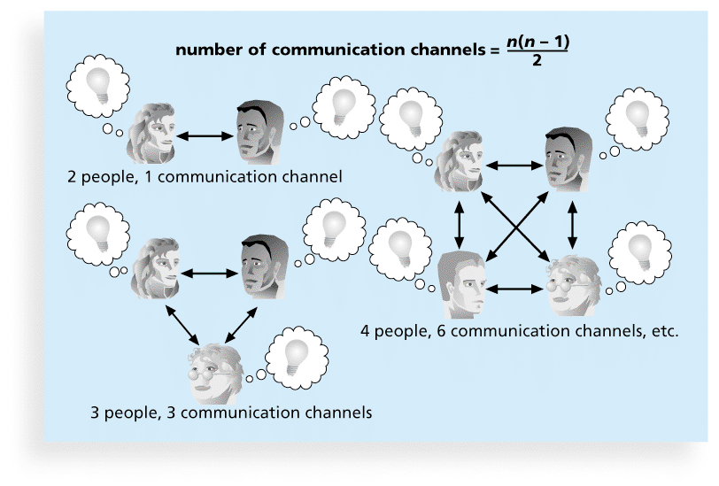
Figure 10-2. The Impact of the Number of People on Communications Channels

Slide 13
Planning Communications Management
Every project should include some type of communications management plan, a document that guides project communications
The communications management plan varies with the needs of the project, but some type of written plan should always be prepared
For small projects, the communications management plan can be part of the team contract
For large projects, it should be a separate document

Slide 14
Communications Management Plan Contents
Stakeholder communications requirements
Information to be communicated, including format, content, and level of detail
Who will receive the information and who will produce it
Suggested methods or technologies for conveying the information
Frequency of communication
Escalation procedures for resolving issues
Revision procedures for updating the communications management plan
A glossary of common terminology

Slide 15
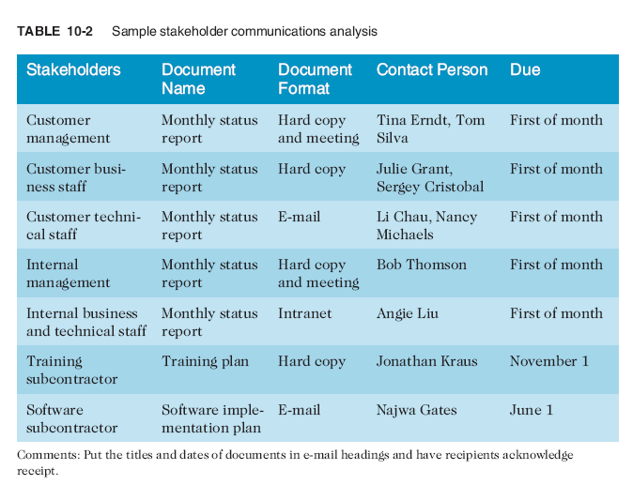
Table 10-1. Sample Stakeholder Analysis for Project Communications

Slide 16
Managing Communications
Managing communications is a large part of a project manager’s job
Getting project information to the right people at the right time and in a useful format is just as important as developing the information in the first place
Important considerations include the use of technology, the appropriate methods and media to use, and performance reporting

Slide 17
Using Technology to Enhance Creation and Distribution
Technology can facilitate the process of creating and distributing information, when used properly
It is important to select the appropriate communication method and media

Slide 18
Classifications for Communication Methods
Interactive communication: Two or more people interact to exchange information via meetings, phone calls, or video conferencing. Most effective way to ensure common understanding
Push communication: Information is sent or pushed to recipients without their request via reports, e-mails, faxes, voice mails, and other means. Ensures that the information is distributed, but does not ensure that it was received or understood
Pull communication: Information is sent to recipients at their request via Web sites, bulletin boards, e-learning, knowledge repositories like blogs, and other means

Slide 19
Reporting Performance
Performance reporting keeps stakeholders informed about how resources are being used to achieve project objectives
Status reports describe where the project stands at a specific point in time
Progress reports describe what the project team has accomplished during a certaiperiod of time
Forecasts predict future project status and progress based on past information and trends

Slide 20
Controlling Communications
The main goal of controlling communications is to ensure the optimal flow of information throughout the entire project life cycle
The project manager and project team should use their various reporting systems, expert judgment, and meetings to assess how well communications are working. If problems exist, the project manager and team need to take action, which often requires changes to the earlier processes of planning and managing project communications
It is often beneficial to have a facilitator from outside the project team assess how well communications are working

Slide 21
Suggestions for Improving Project Communications
Develop better communication skills
Run effective meetings
Use e-mail and other technologies effectively
Use templates for project communications

Slide 22
Running Effective Meetings
Determine if a meeting can be avoided
Define the purpose and intended outcome of the meeting
Determine who should attend the meeting
Provide an agenda to participants before the meeting
Prepare handouts and visual aids, and make logistical arrangements ahead of time
Run the meeting professionally
Set the ground rules for the meeting
Build relationships

Slide 23
Sample Collaborative Tools
A SharePoint portal allows users to create custom Web sites to access documents and applications stored on shared devices
Google Docs allow users to create, share, and edit documents, spreadsheets, and presentations online
A wiki is a Web site designed to enable anyone who accesses it to contribute or modify Web page content
Kanban boards visually show tasks that need to be done, are in progress, or are completed

Slide 24
Using Templates for Project Communications
Many technical people are afraid to ask for help
Providing examples and templates for project communications saves time and money
Organizations can develop their own templates, use some provided by outside organizations, or use samples from textbooks
Recall that research shows that companies that excel in project management make effective use of templates

Slide 25
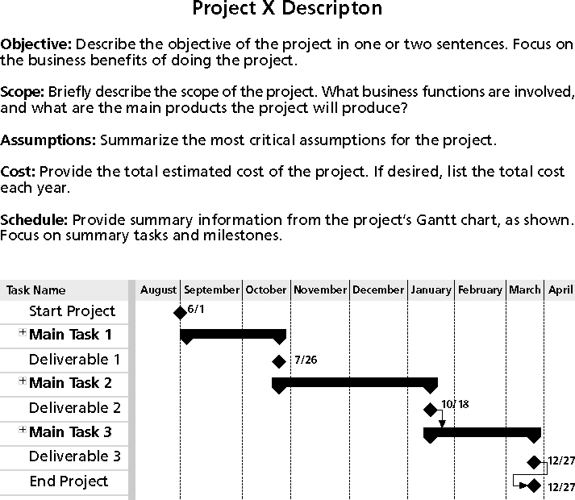
Figure 10-3. Sample Template for a Project Description

Slide 26
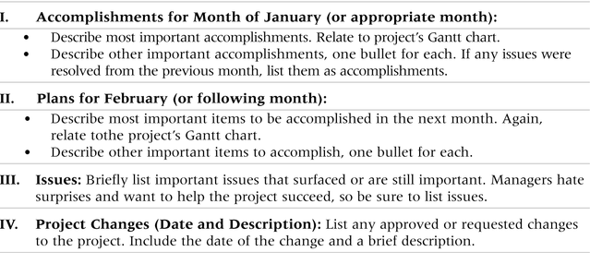
Table 10-3. Sample Template for a Monthly Progress Report

Slide 27
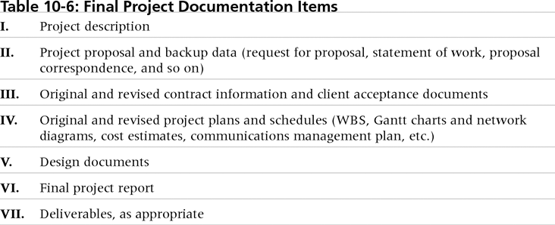
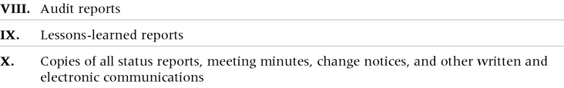
Table 10-4. Final Project Documentation Items

Slide 28
Lessons Learned Reports
The project manager and project team members should each prepare a lessons-learned report
A reflective statement that documents important things an individual learned from working on the project
The project manager often combines information from all of the lessons-learned reports into a project summary report
See template and sample in Chapter 3

Slide 29
Project Archives
It is also important to organize and prepare project archives
Project archives are a complete set of organized project records that provide an accurate history of the project
These archives can provide valuable information for future projects as well

Slide 30
Project Web Sites
Many project teams create a project Web site to store important product documents and other information
Can create the site using various types of software, such as enterprise project management software
Several project management tools can be used on multiple devices

Slide 31
Using Software to Assist in Project Communications
There are many software tools to aid in project communications
Today many people telecommute or work remotely at least part-time
Project management software includes new capabilities to enhance virtual communications
While technology can aid in the communications process, it is not the most important. Far more important is improving an organization’s ability to communicate, which often involves cultural change

Slide 32
Chapter Summary
The goal of project communications management is to ensure timely and appropriate generation, collection, dissemination, storage, and disposition of project information
Main process include:
Plan communications management
Manage communications
Control communications

Slide 33
Questions & answers

